Slide 1


Crash Course on GIT
Carlos Diego N. Damasceno, MSc, PhD candidate
damascenodiego@usp.br

Slide 2
Agenda
Version Control
Version Control System (VCS)
Distributed VCS
Crash Course on Git
Git history
Basic concepts
Setting up a local repository
Setting up a remote repository @ Github
Cloning a remote repository @ Github
References

Slide 3

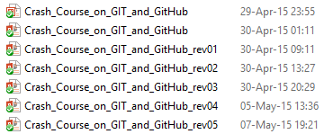

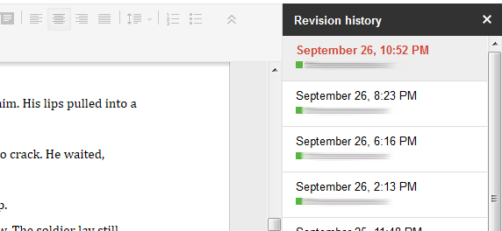
Version Control

Slide 4
Version Control System
“A software that helps developers on a software team to work together and also archives a complete history of their work.”
[Sink, 2011]
Eric Sink. 2011. Version Control by Example (1st ed.). PYOW Sports Marketing.

Slide 5
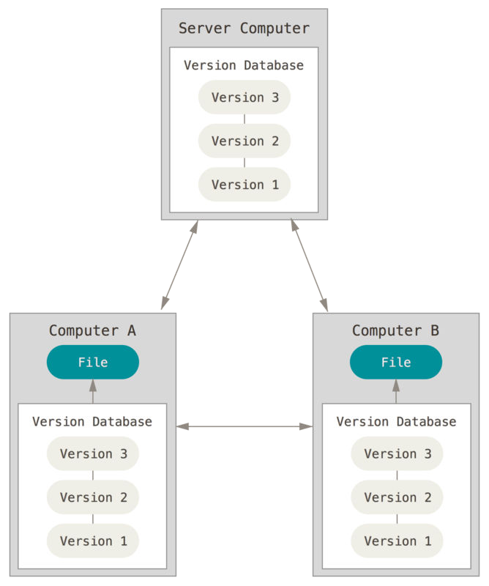
Distributed Version Control System
Distributed VCS (DVCS)
Remote Server
Collaborative work
Several remote servers
Full backup
Examples
Mercurial (hg)
https://www.mercurial-scm.org/
git
http://git-scm.com/
https://github.com/
Distributed version control [Chacon & Straub, 2014]
Scott Chacon and Ben Straub. 2014. Pro Git (2nd ed.). Apress, Berkeley, CA, USA.

Slide 6
Crash Course on GIT
Git history

Slide 7




Git history
Linus Torvalds → Linux OS → Git
1991–2002: Changes passed around as patches/archived files
2002: BitKeeper → Proprietary DVCS
2005: Linux-BitKeeper relationship broke down
Reverse-engineering Bitkeeper → Andrew Tridgell (e.g., samba)

Slide 8
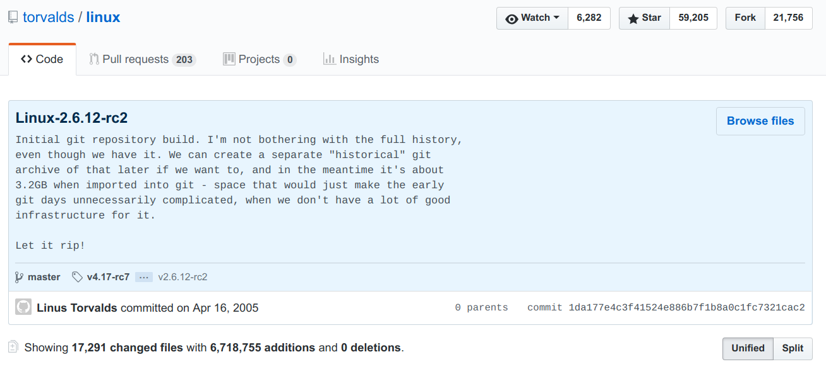
Git history
https://github.com/torvalds/linux/releases/tag/v2.6.12-rc2

Slide 9

Git history

Slide 10
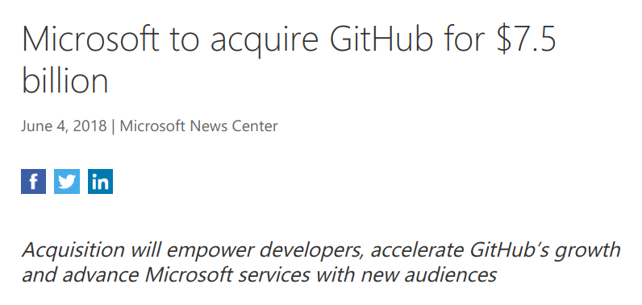

Git history
https://news.microsoft.com/2018/06/04/microsoft-to-acquire-github-for-7-5-billion/

Slide 11
Crash Course on GIT
Basic concepts

Slide 12
Git basic concepts
workspace
staging
local repository
remote repository
git add/mv/rm
git commit
git commit -a
git reset
git push
git reset/checkout
git diff
git fetch
git diff <commit>
git clone/pull

Slide 13
Git basic concepts
workspace
staging
local repository
remote repository
git add
git commit
git commit -a
git push
git checkout
git diff <commit>
git clone

Slide 14
Crash Course on GIT
Git clients

Slide 15


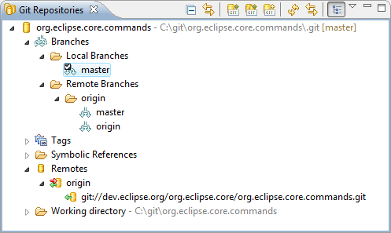
Git clients - Eclipse
Eclipse Git (EGit)
Eclipse plug-in
Allows you to use Git directly within Eclipse IDE
Perspective and Views
Based on the JGit library.
Java library implementing Git functionalities
http://wiki.eclipse.org/EGit/User_Guide

Slide 16

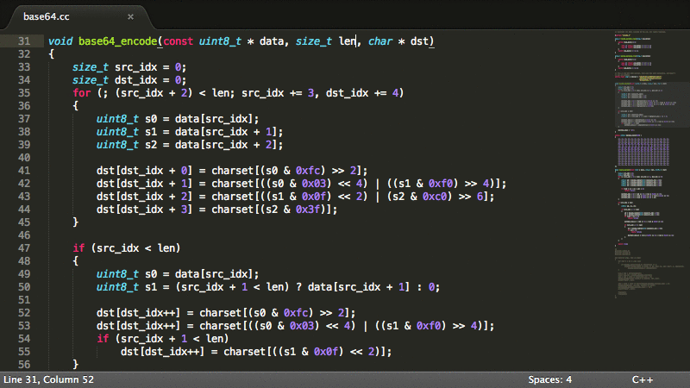
Git clients - Sublime
https://www.sublimetext.com/

Slide 17
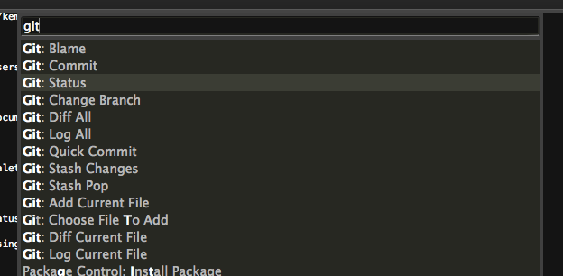
Git clients - Sublime
https://github.com/kemayo/sublime-text-git

Slide 18
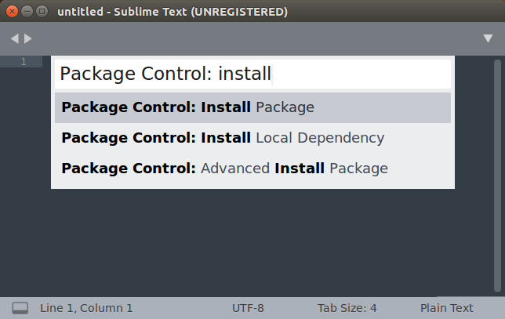
Git @ Sublime - How to install
Ctrl + Shift + P

Slide 19
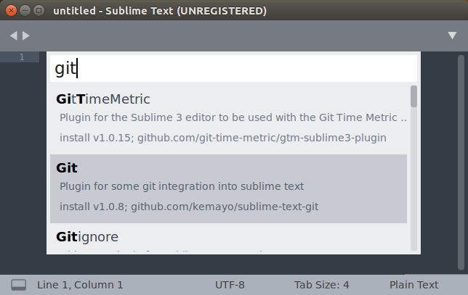
Git @ Sublime - How to install

Slide 20
Crash Course on GIT
Setting up a local repository

Slide 21

Git - How to install
Download - http://git-scm.com/download
Ubuntu Linux - Package management tool
# ~ apt install git
Notes:
Access http://git-scm.com/download

Slide 22
Tasks
Create./git_course folder
Create ./git_course/myCalculator.cpp file
Read, sum and print two integer values
Create ./git_course/README text file
Describe your project

Slide 23
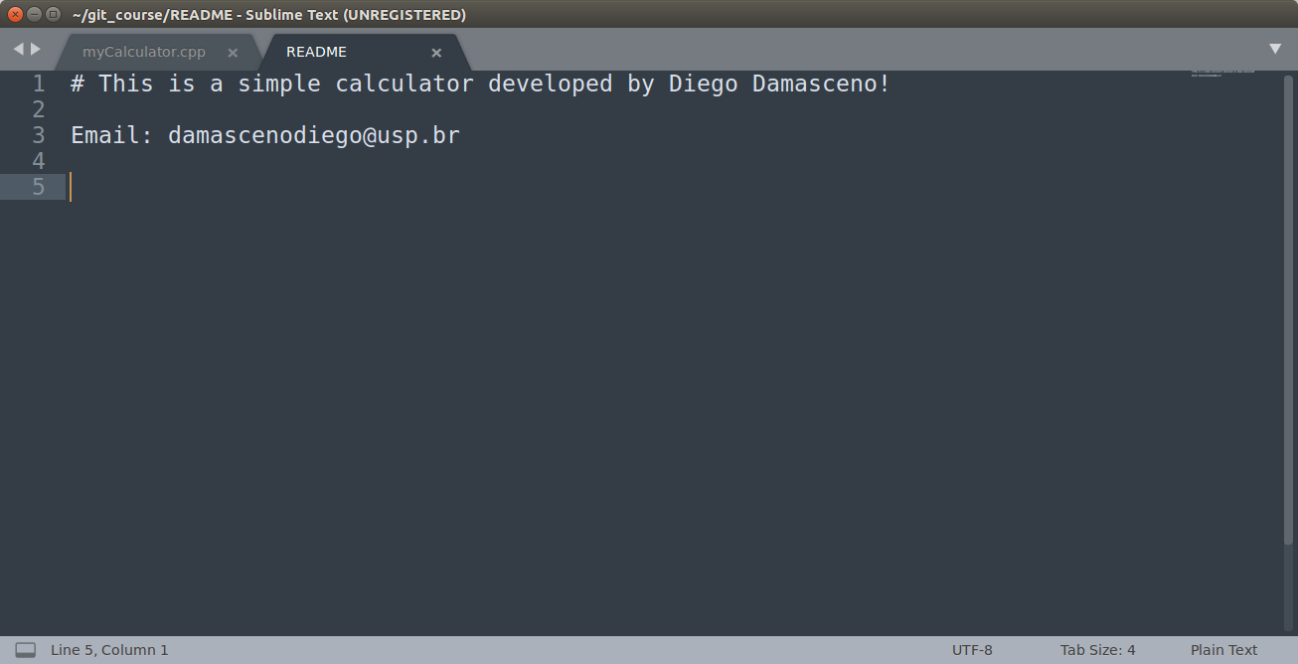
Example → myCalculator.cpp

Slide 24
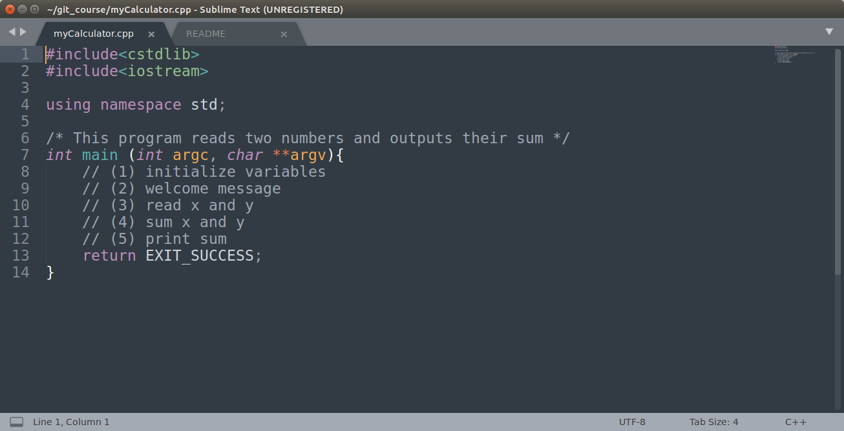
Example → myCalculator.cpp

Slide 25
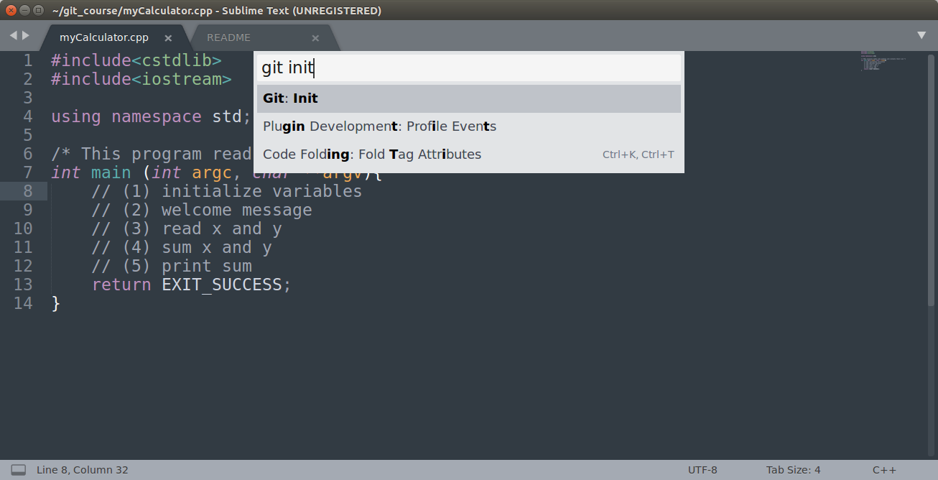
Initialize the Git Repository
Notes:
git init This command allows to setup a git repository. It creates the .git directory – a Git repository skeleton. At this point nothing is tracked!

Slide 26
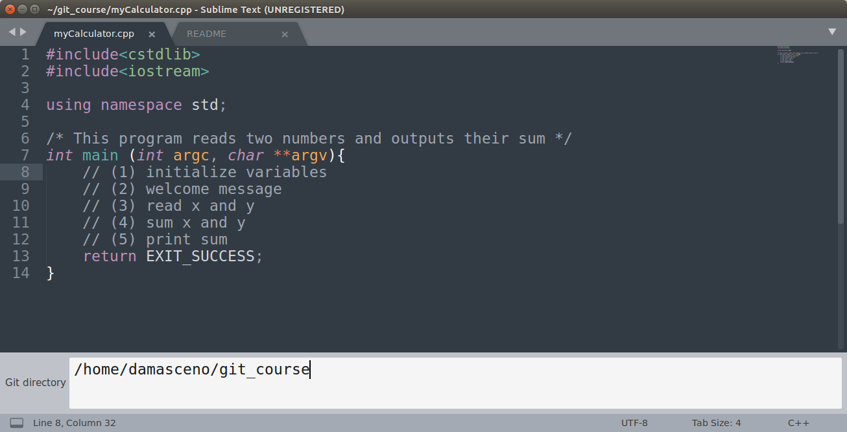
Initialize the Git Repository

Slide 27
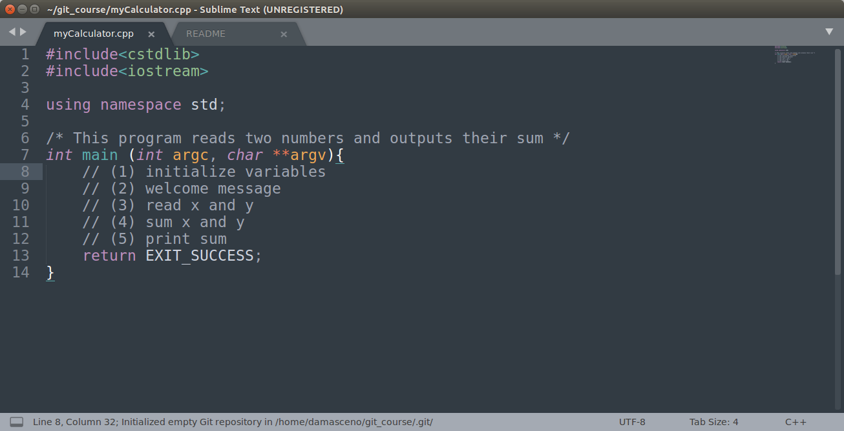
Initialize the Git Repository

Slide 28
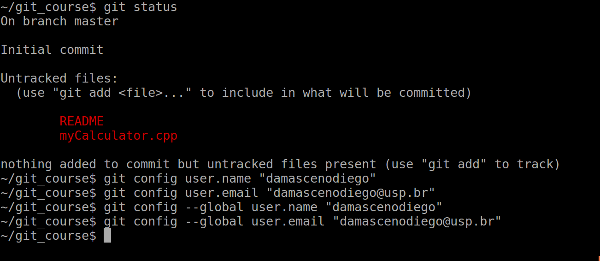
Setting global/local configuration
git config --global user.name "Your Name"
git config --global user.email "Your E-mail"
Notes:
git config This command allows to check and edit the settings of a specific project. E.g. username (user.name) and email (user.email). IMPORTANT TO SET UP PARAMETERS!!! → “TELL ME WHO YOU ARE!!!!!!!” git config -l git config user.name git config user.email git config --global user.name "Your Name" git config --global user.email "Your E-mail"

Slide 29
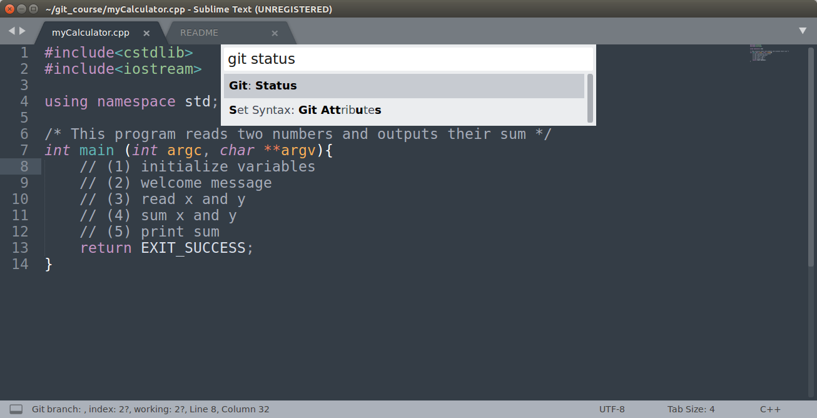
Git status
Notes:
git status This command shows differences between working directory, staging area and last commit in the repository.

Slide 30
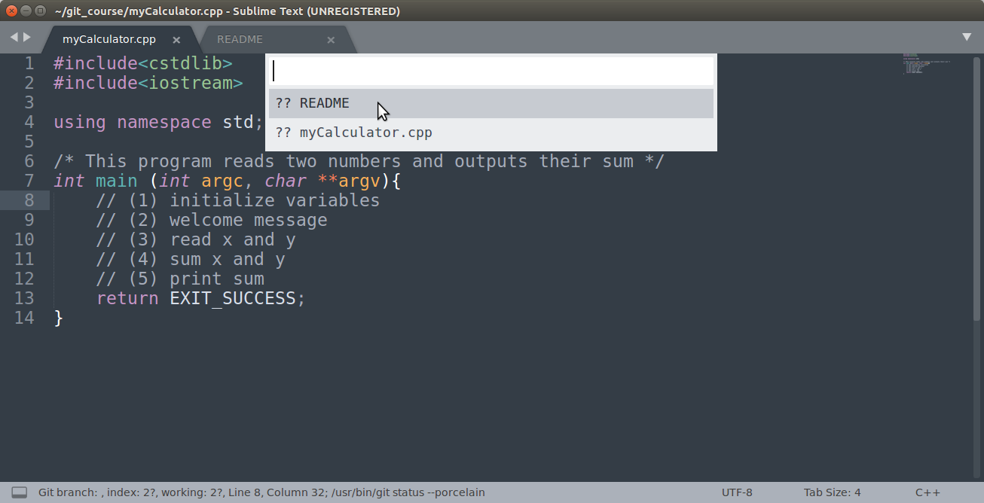
Git status

Slide 31
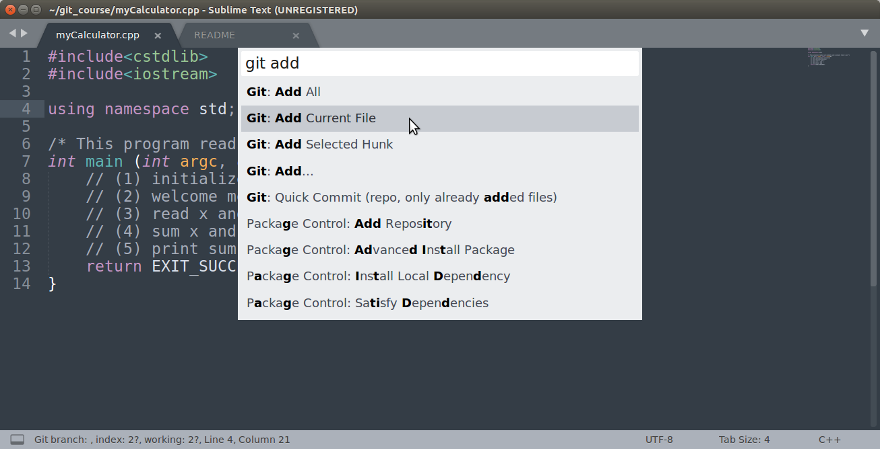
Add myCalculator.cpp to staging area
Notes:
git add This command updates the index (staging area) using the current content found in the working tree (working directory), to prepare the content staged for the next commit.

Slide 32
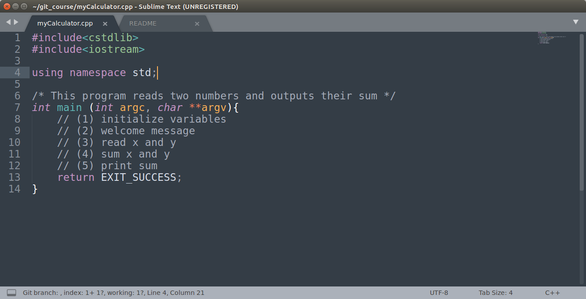
Add myCalculator.cpp to staging area

Slide 33
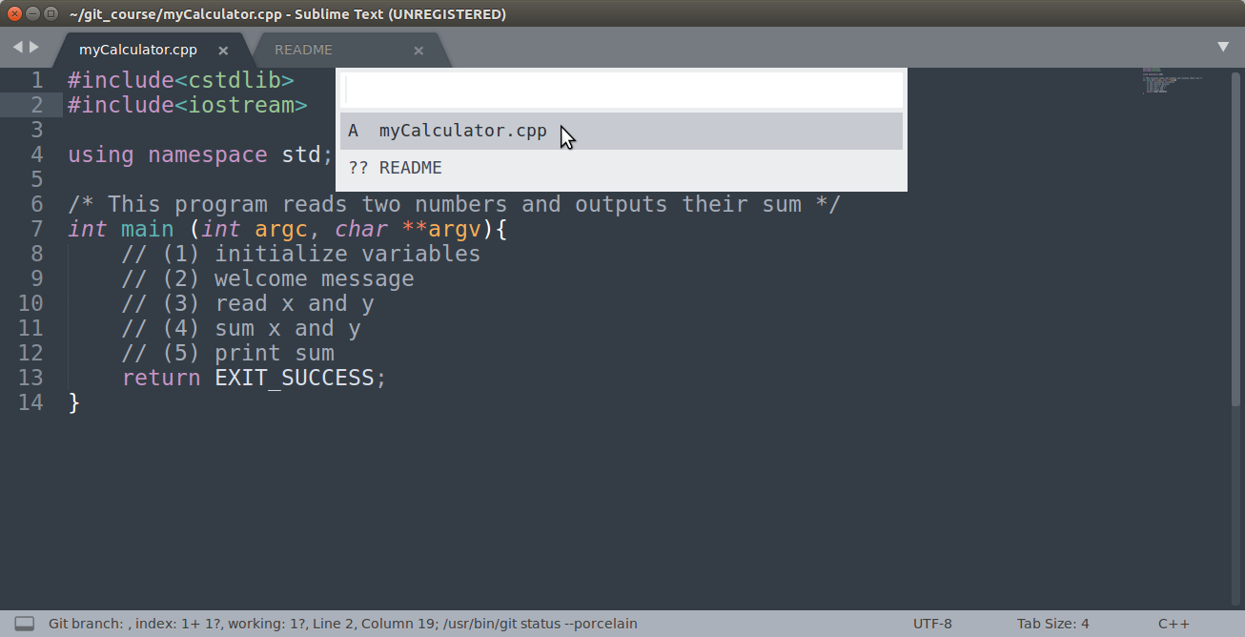
Git status

Slide 34
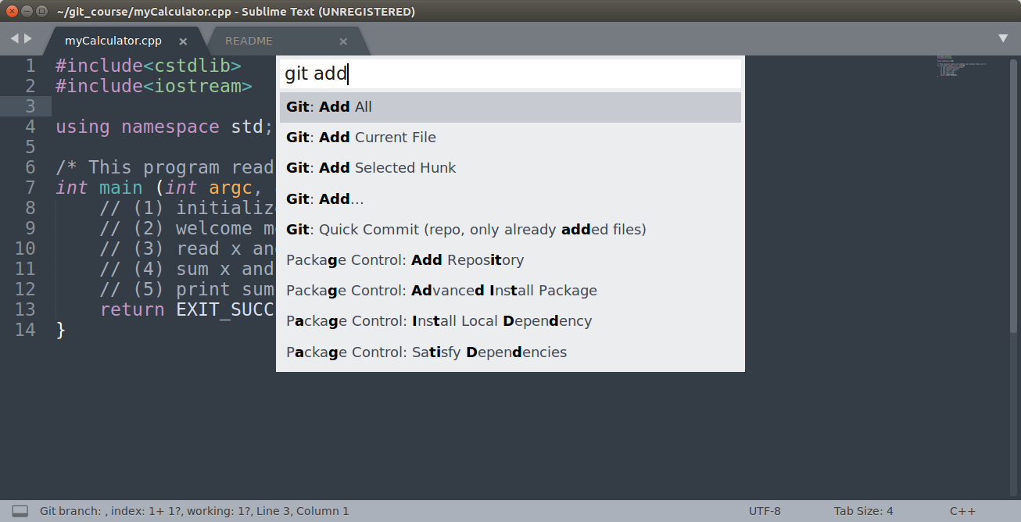
Add all files to staging area

Slide 35
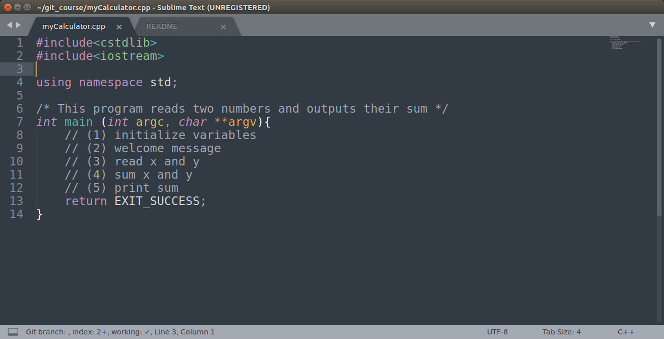
Add all files to staging area

Slide 36
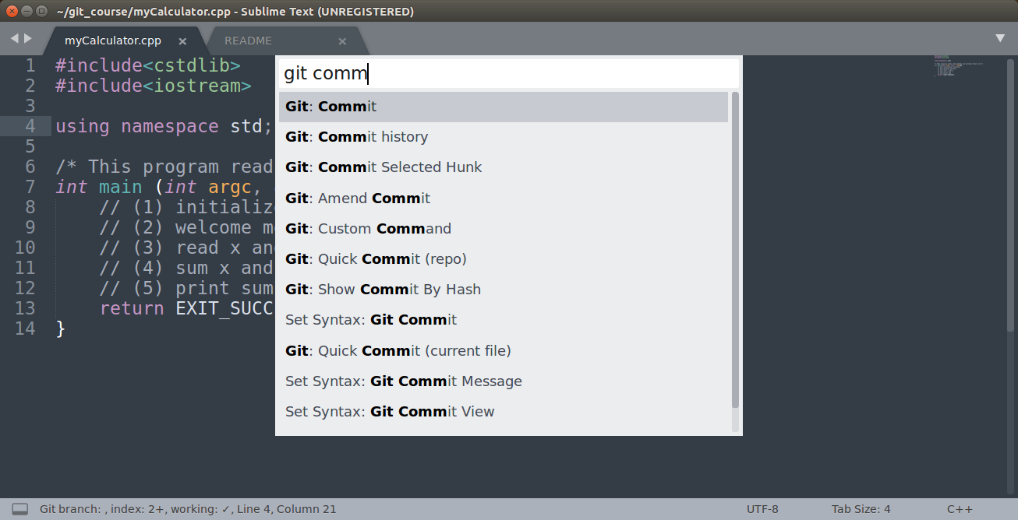
Commit files
Notes:
git commit Stores the current contents of the index (staging area) in a new commit along with a log message from the user describing the changes.

Slide 37
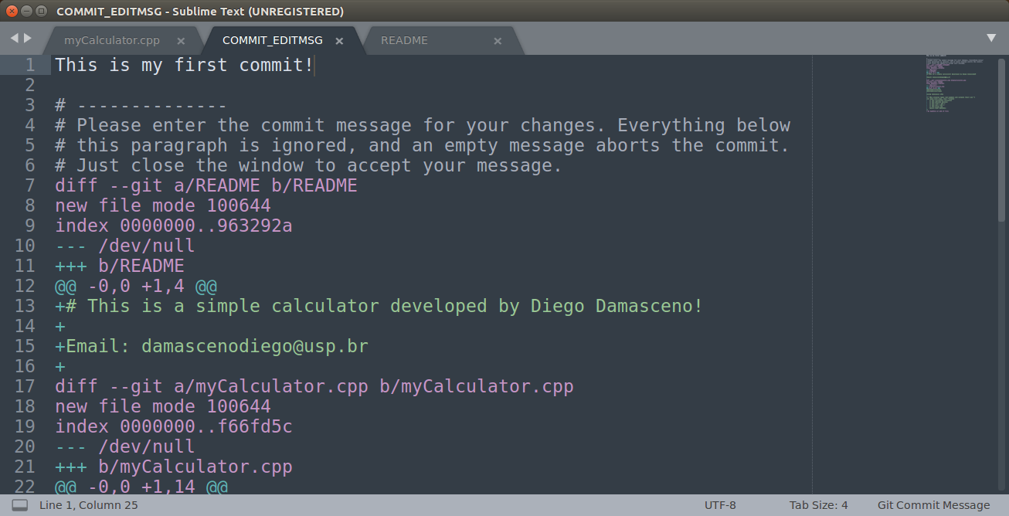
Commit files

Slide 38
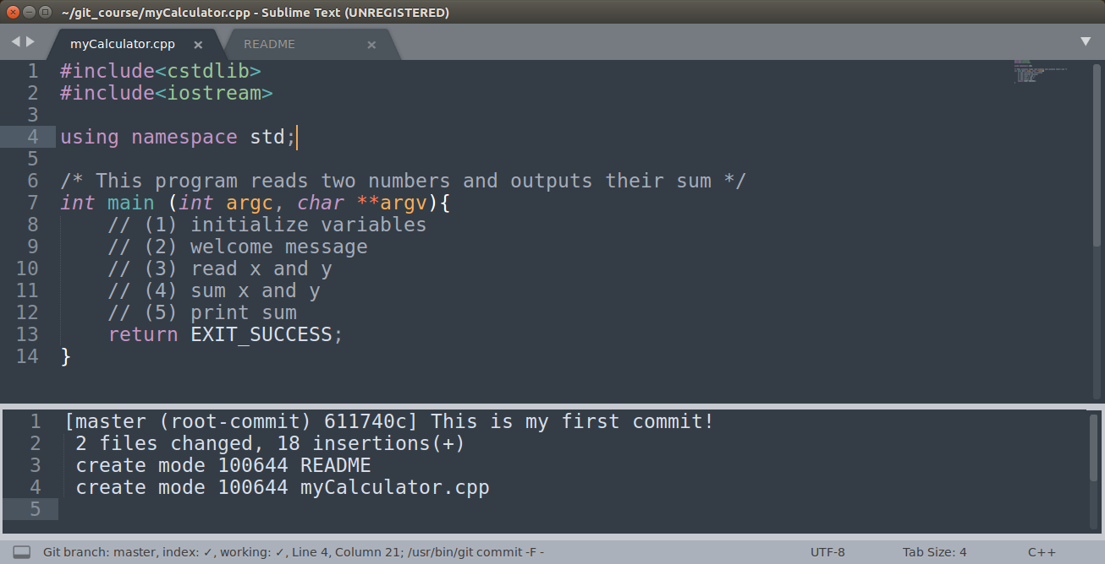
Commit files

Slide 39
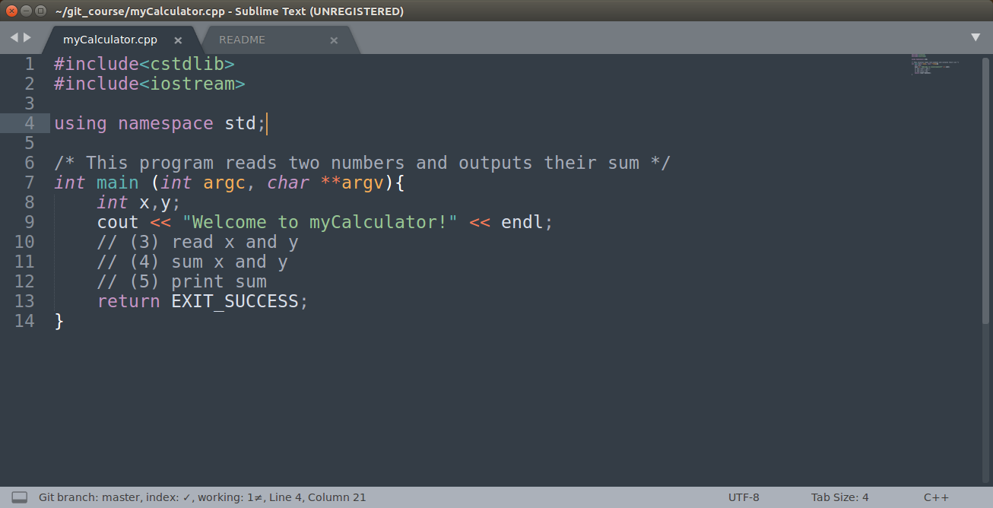
Edit and save your file...

Slide 40
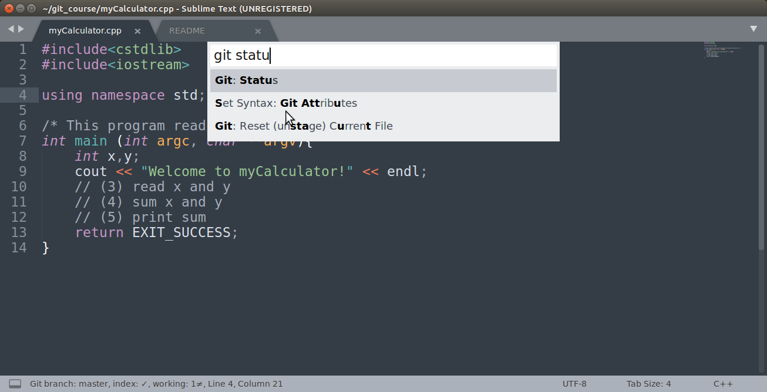
Git status

Slide 41
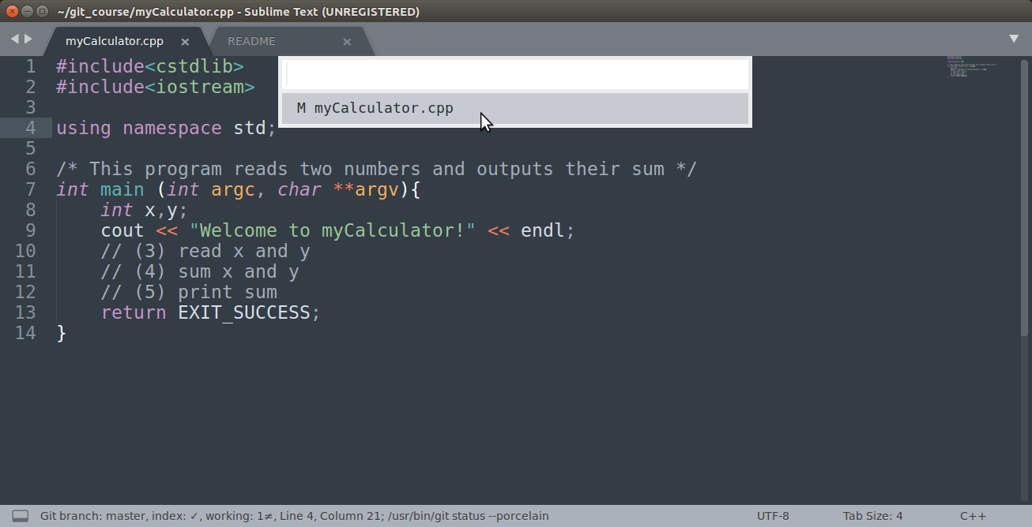
Git status

Slide 42
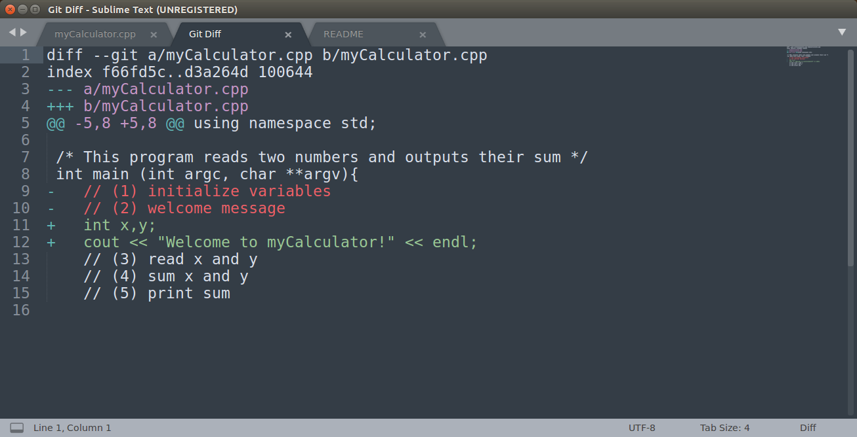
Git diff

Slide 43
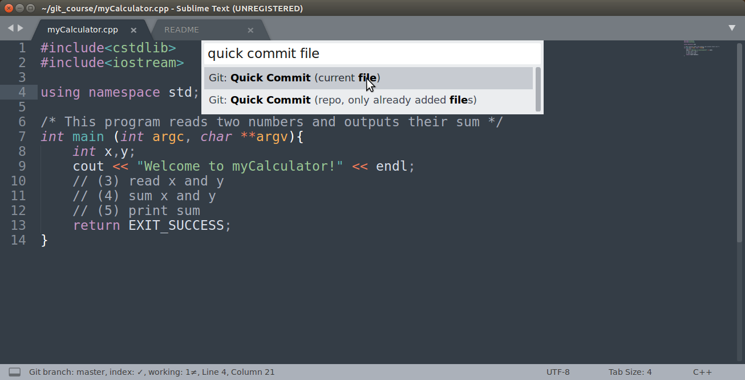
Quick commit

Slide 44
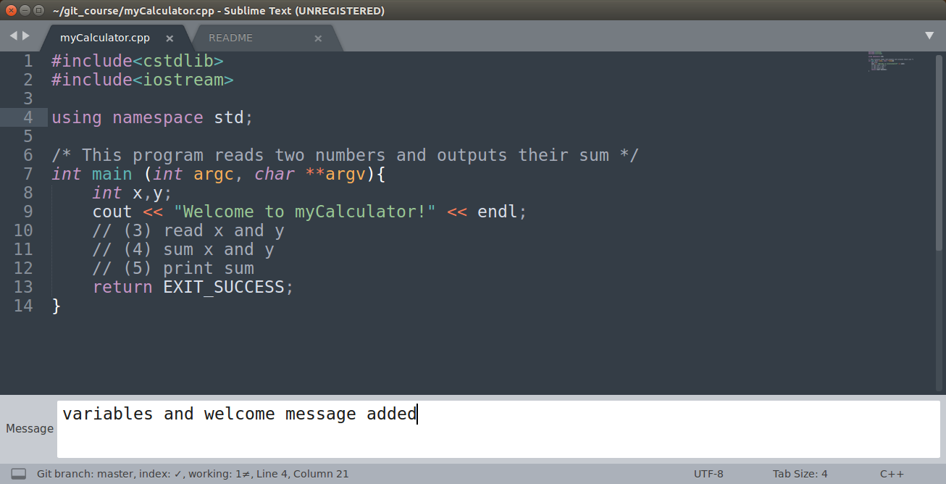
Quick commit

Slide 45
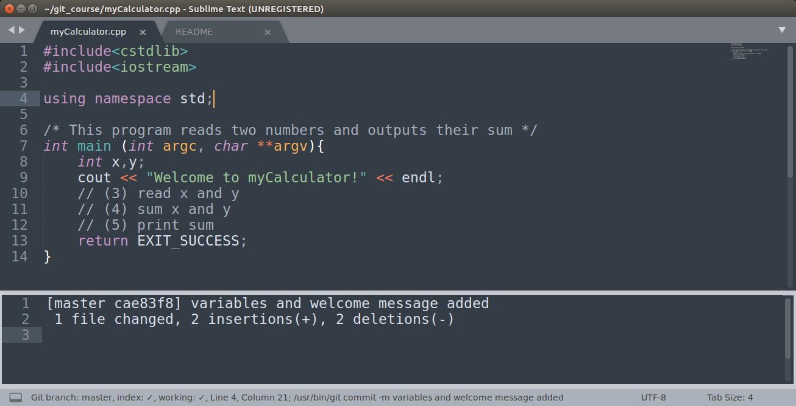
Quick commit

Slide 46
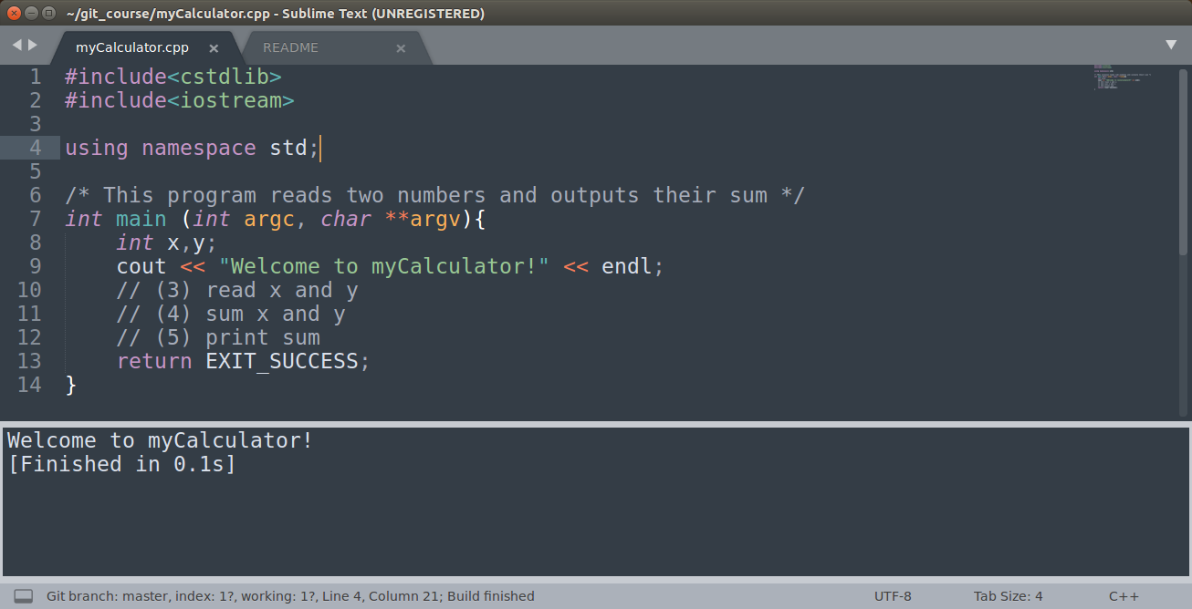
Build and run program

Slide 47
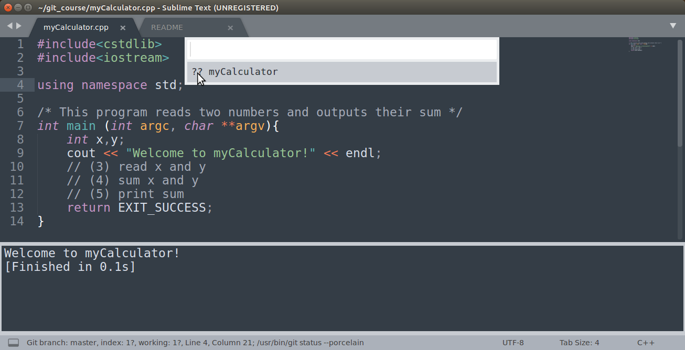
Git status

Slide 48
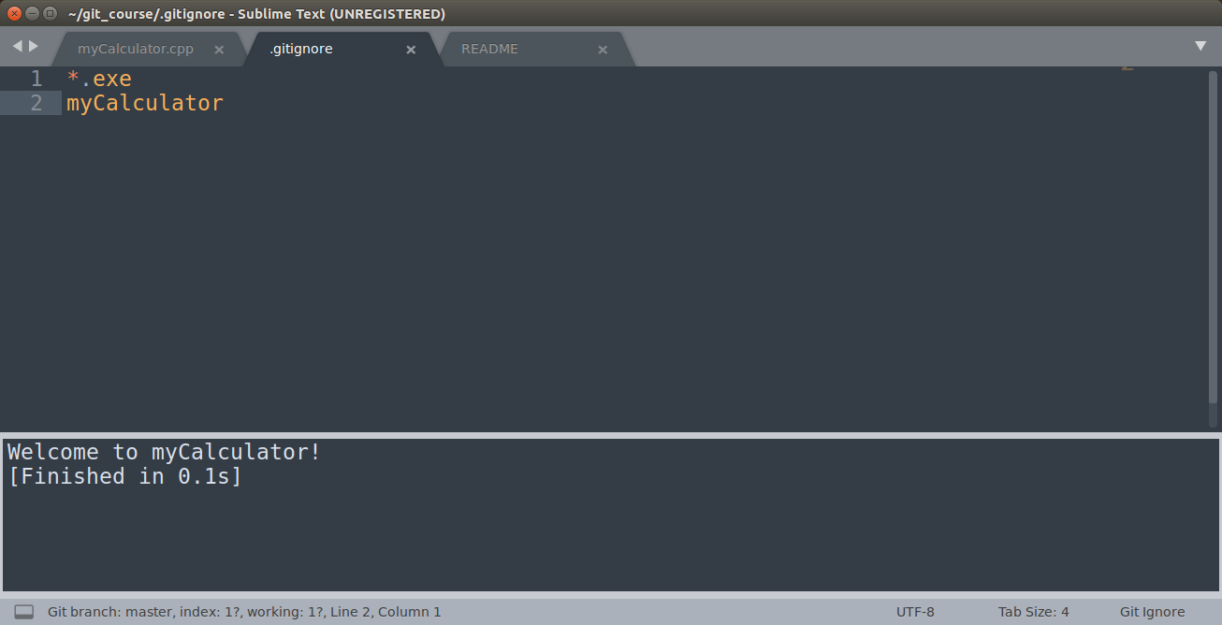
Ignoring specific files (.gitignore)

Slide 49
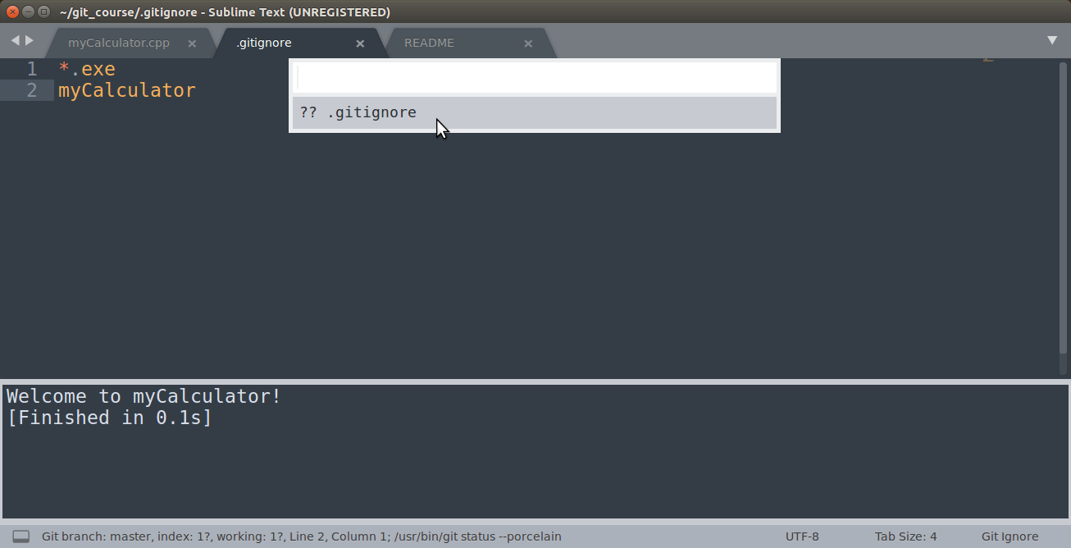
Git status

Slide 50
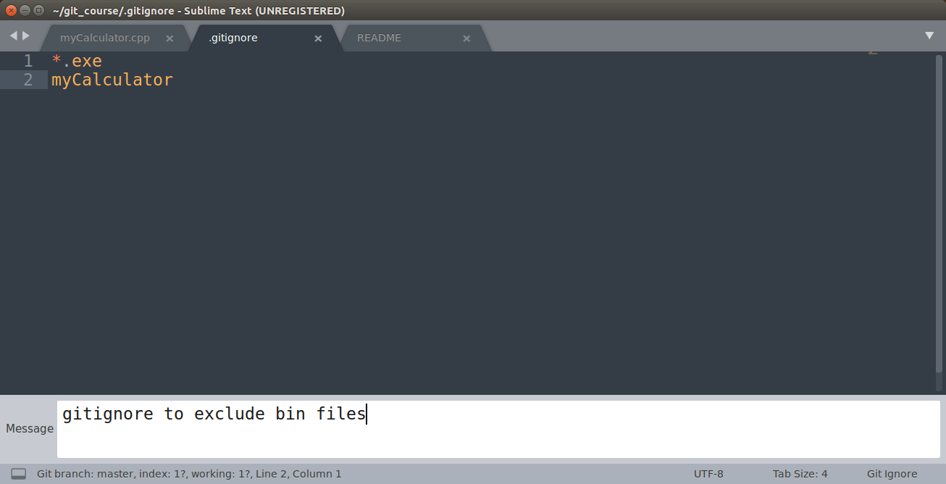
Quick commit .gitignore file

Slide 51
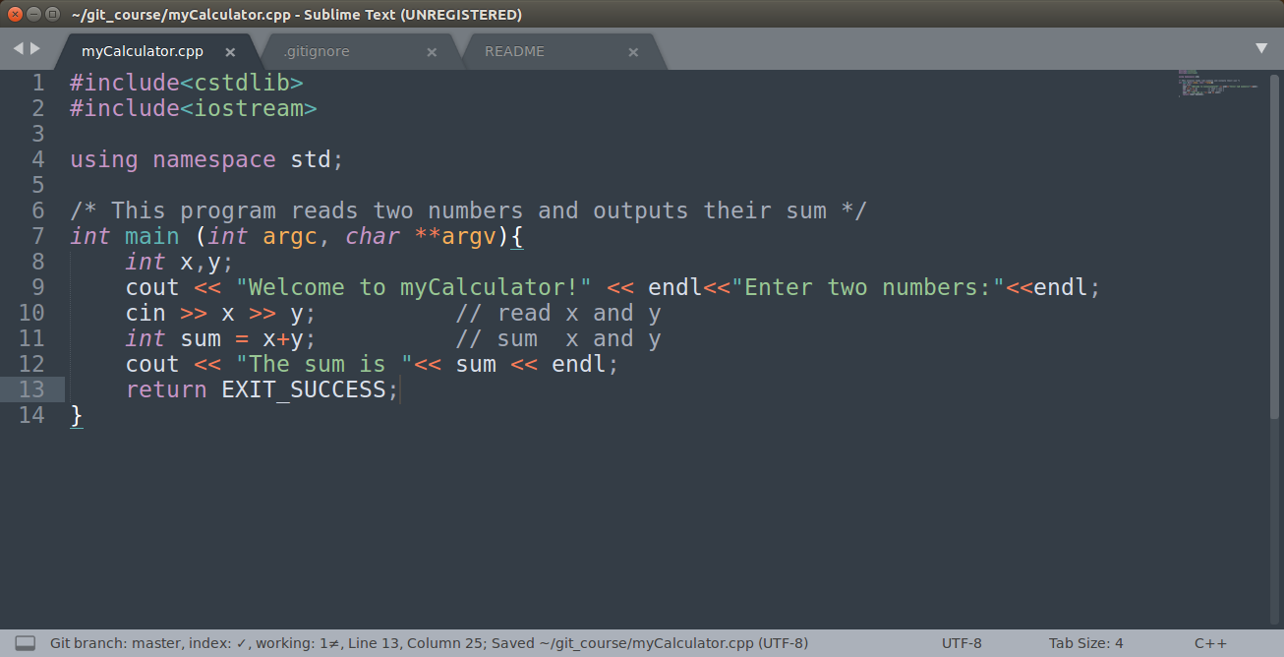
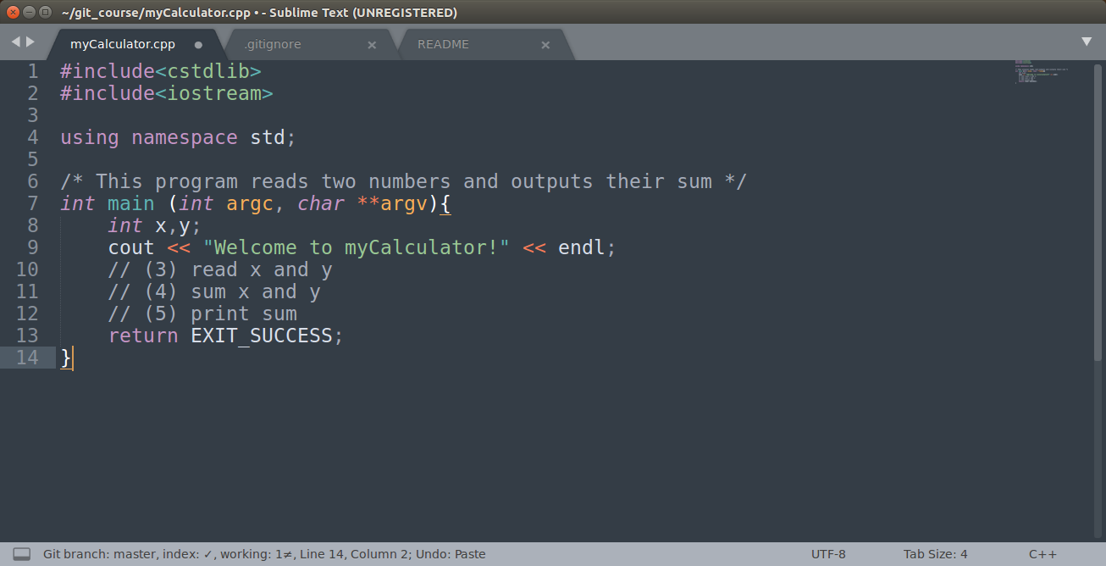
Complete myCalculator.cpp

Slide 52
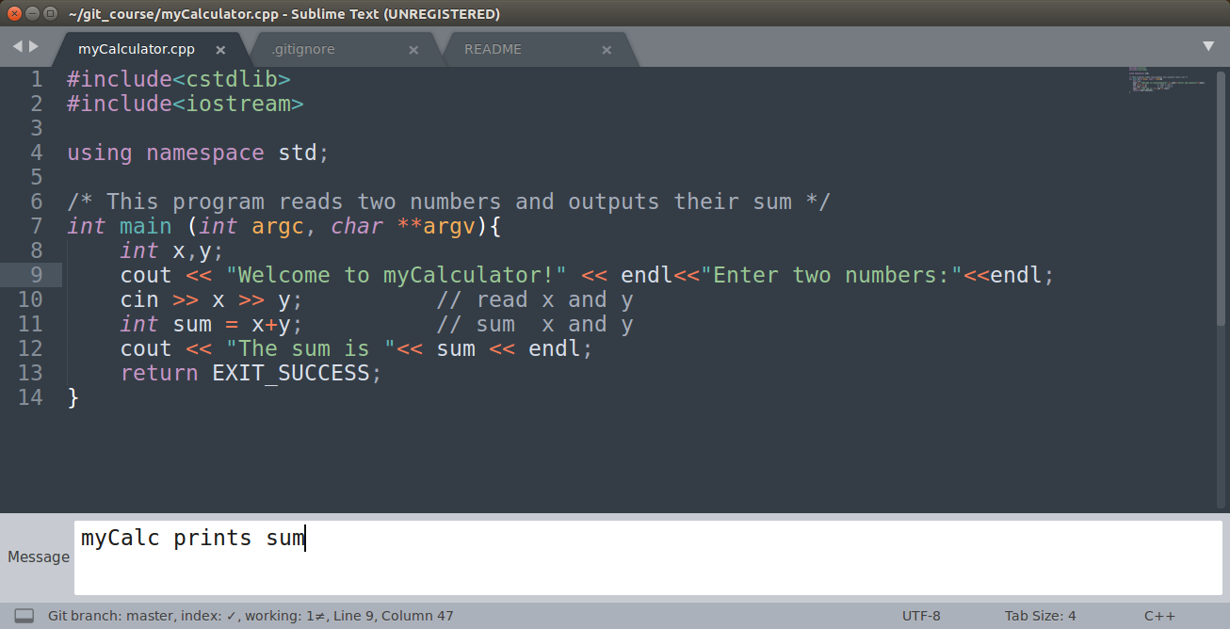
Quick commit

Slide 53
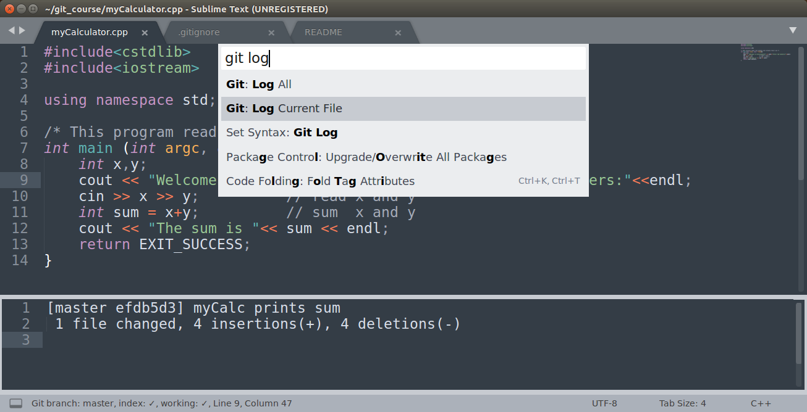
Git log

Slide 54
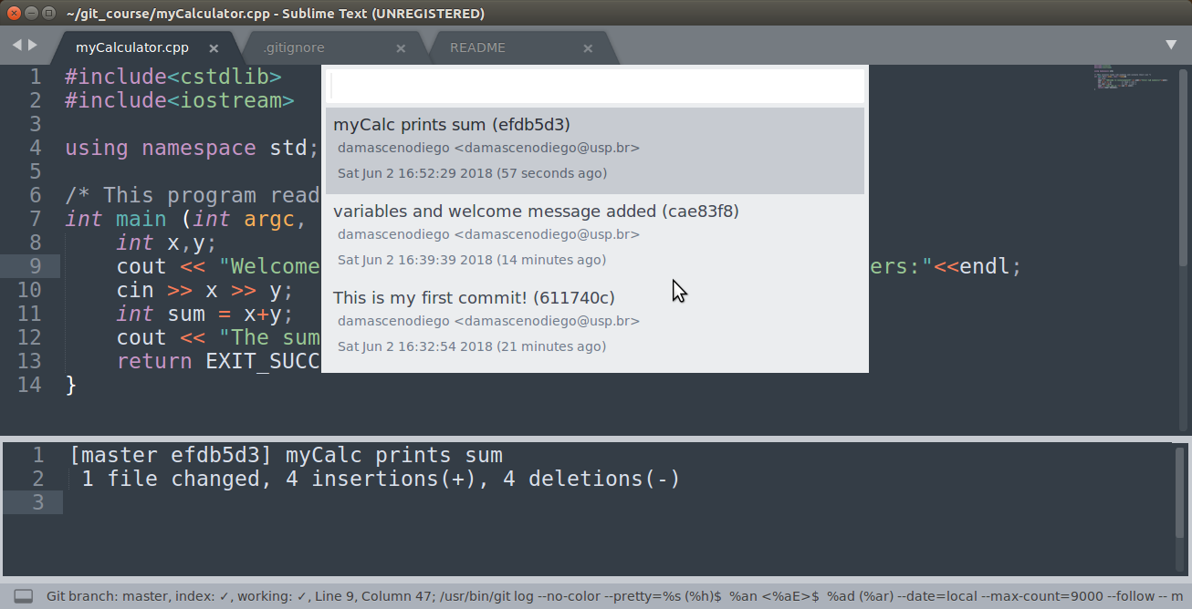
Git log

Slide 55
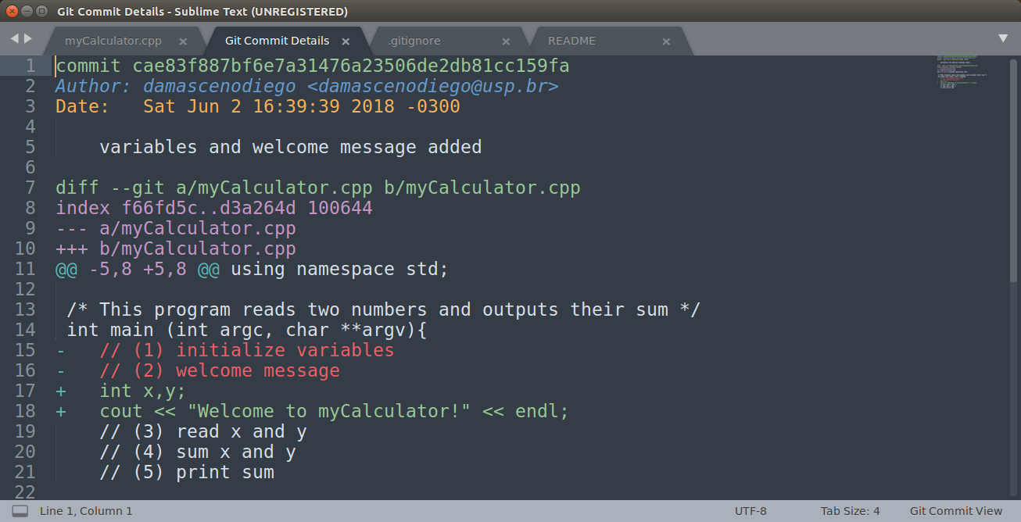
Git log

Slide 56
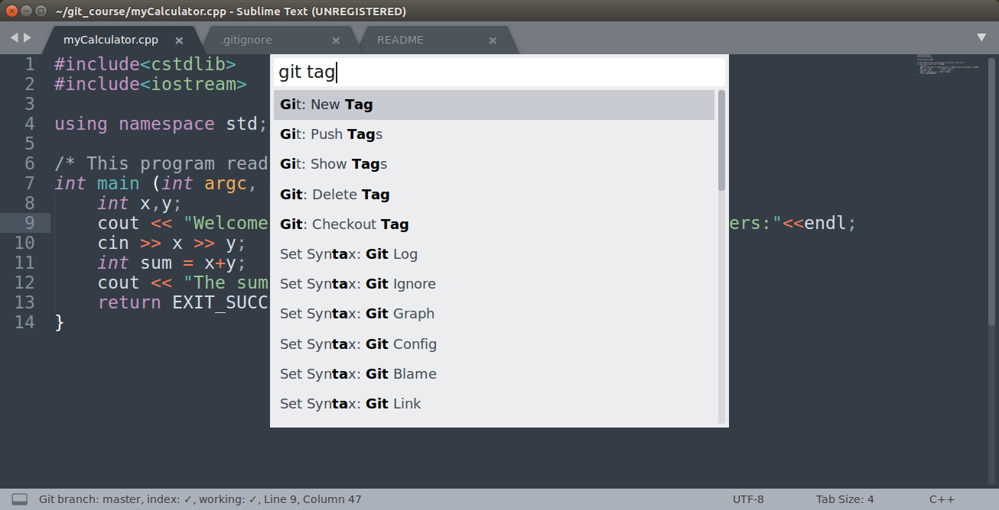
Create tag

Slide 57
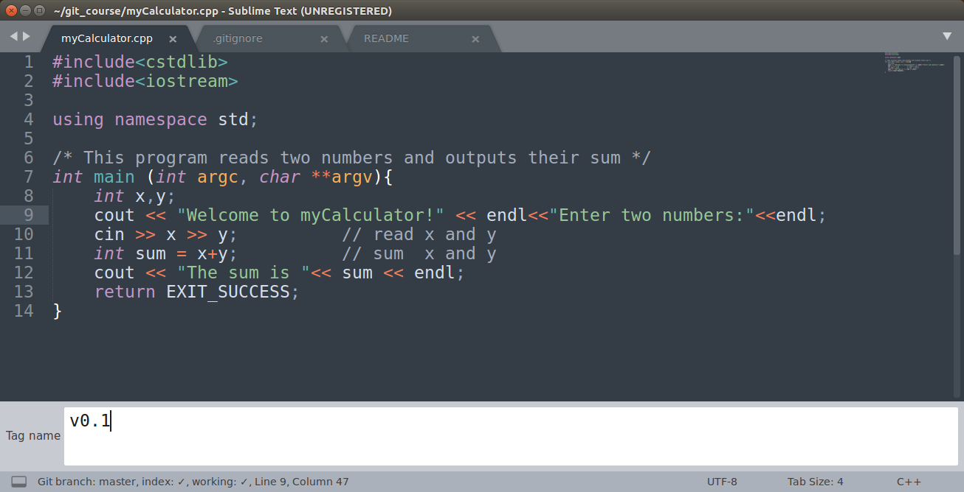
Create tag

Slide 58
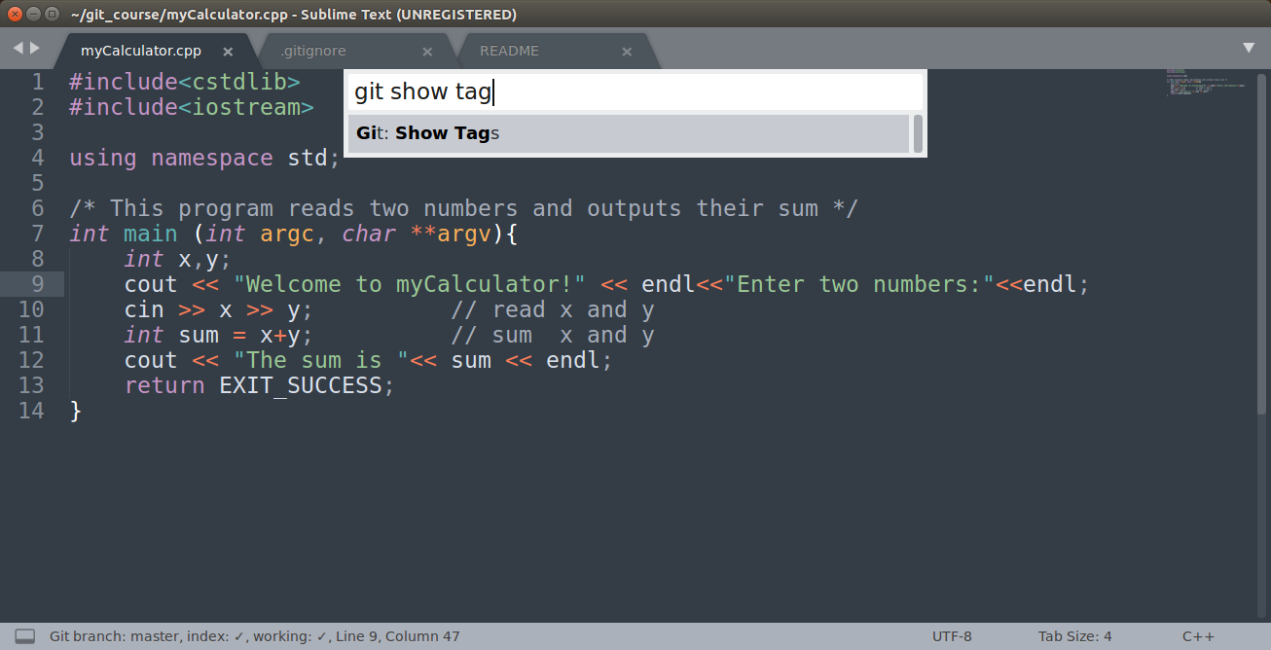
Show tags

Slide 59
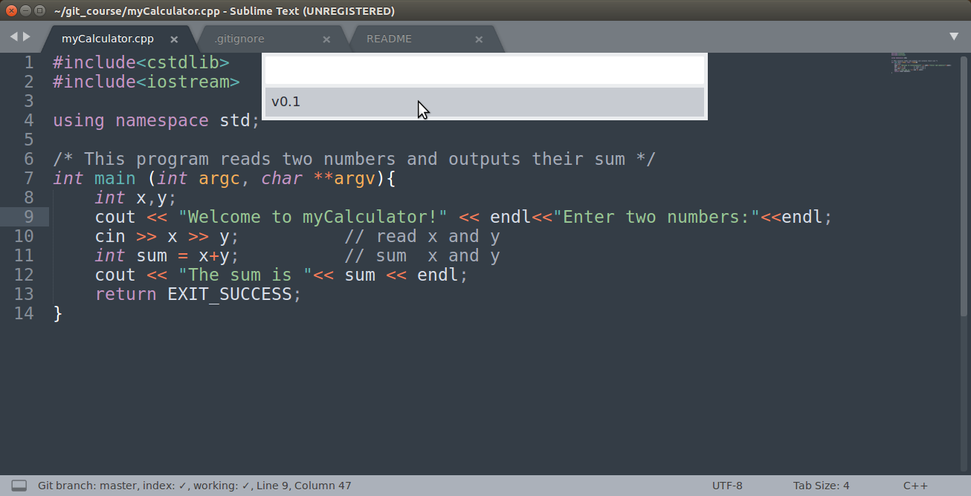
Show tags

Slide 60
Crash Course on GIT
Setting up a remote repository

Slide 61

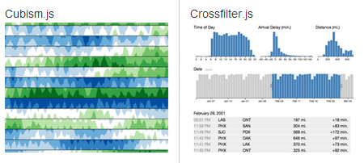

GitHub
Github
Social coding
Open source
9.3M people collaborating
21.9M repositories
https://github.com
D3: JavaScript virtualization library for SVG and HTML
Ruby on Rails: Popular Web framework based on Ruby

Slide 62
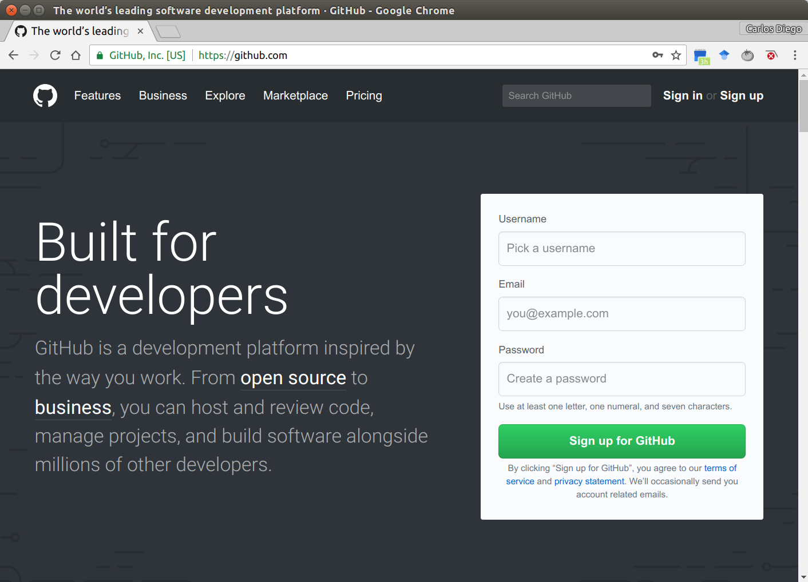
GitHub
← Username
← Email
← Password
← Click here!

Slide 63

Creating a remote repository @ GitHub

Slide 64

myCalculator remote repository @ GitHub

Slide 65

Push to remote repository @ GitHub
git remote add origin <repository URL>
git config --global push.default simple
git config --global credential.helper 'cache --timeout 1800'
git push --set-upstream origin master

Slide 66

Push to remote repository @ GitHub

Slide 67

Push to remote repository @ GitHub

Slide 68

Add collaborators @ GitHub

Slide 69

Add collaborators @ GitHub

Slide 70

Add collaborators @ GitHub

Slide 71

Add multiplication as TODO

Slide 72

Add multiplication as TODO

Slide 73

Quick commit

Slide 74

Quick commit

Slide 75

Push current branch

Slide 76

Push current branch

Slide 77
Push current branch

Slide 78

Push current branch

Slide 79
Crash Course on GIT
Cloning a remote repository

Slide 80

Cloning a remote repository

Slide 81

Cloning a remote repository
git clone <repository URL>

Slide 82
Crash Course on GIT
Branching and Merging

Slide 83

git init @ Alice
HEAD
(Alice)
master
c0

Slide 84
git commit @ Alice
HEAD
(Alice)
master
c0
c1

Slide 85
git tag @ Alice
HEAD
(Alice)
master
v0.1
c0
c1

Slide 86
git commit @ Alice
HEAD
(Alice)
v0.1
master
c0
c1
c2

Slide 87
git clone @ Bob
HEAD
(Bob)
HEAD
(Alice)
v0.1
master
c0
c1
c2

Slide 88
git branch @ Bob
HEAD
(Alice)
v0.1
master
c0
c1
c2
mult
HEAD
(Bob)

Slide 89
git commit @ Bob
HEAD
(Alice)
v0.1
master
c0
c1
c2
c3
mult
HEAD
(Bob)

Slide 90
git commit @ Alice
HEAD
(Alice)
master
v0.1
c4
c0
c1
c2
c3
mult
HEAD
(Bob)

Slide 91
git commit @ Alice
HEAD
(Alice)
master
v0.1
c4
c5
c0
c1
c2
c3
mult
HEAD
(Bob)

Slide 92
git commit @ Bob
HEAD
(Alice)
master
v0.1
c4
c5
c0
c1
c2
c3
c6
mult
HEAD
(Bob)

Slide 93
git merge @ Alice
HEAD
(Alice)
v0.1
master
c4
c5
c0
c1
c2
c7
c3
c6
mult
HEAD
(Bob)

Slide 94
git checkout master @ Bob
HEAD
(Alice)
HEAD
(Bob)
v0.1
master
c4
c5
c0
c1
c2
c7
c3
c6
mult

Slide 95

Create a Branch
Notes:
git branch The command creates a new branch head named <branch name>. With no arguments, branches are listed; the current branch will be highlighted with an asterisk.

Slide 96

Create a Branch

Slide 97

Create a Branch

Slide 98

Add print_multiplication() to multiplication

Slide 99

Quick commit

Slide 100

Push to multiplication branch

Slide 101

Push to multiplication branch

Slide 102

Push to multiplication branch

Slide 103
Add multiplication as TODO

Slide 104

Add print_sum() to master

Slide 105

Quick commit and Push to master

Slide 106

Git pull

Slide 107

Git merge

Slide 108

Git merge

Slide 109

Git merge with conflict

Slide 110

Git merge with conflict

Slide 111

Git merge with conflict

Slide 112

Quick commit

Slide 113

Quick commit

Slide 114

Push last commit

Slide 115

Branches at GitHub

Slide 116
References
Books
Eric Sink. 2011. Version Control by Example (1st ed.). PYOW Sports Marketing. (FREE EBOOK)
Scott Chacon and Ben Straub. 2014. Pro Git (2nd ed.). Apress, Berkeley, CA, USA. (FREE EBOOK)
Pressman, R. S. Software engineering: A practitioner’s approach. 5th ed. McGraw-Hill Higher Education, 2001.
Kemper C., Oxley, I. 2012. Foundation Version Control for Web Developers. Apress.
Videos/Courses
Learn Git in 20 Minutes: https://www.youtube.com/watch?v=Y9XZQO1n_7c
The Basics of Git and GitHub: https://www.youtube.com/watch?v=U8GBXvdmHT4
How to Use Git and GitHub: https://www.udacity.com/course/how-to-use-git-and-github--ud775
Web pages
https://try.github.io/
https://confluence.atlassian.com/display/BITBUCKET/Bitbucket+101
https://sourceforge.net/p/forge/documentation/Git/
https://www.atlassian.com/git/tutorials/
http://www.vogella.com/tutorials/EclipseGit/article.html
Notes:
HERE ARE SOME OTHR REFERENCES YOU CAN LOOK LATER

Slide 117


THANK YOU!
http://goo.gl/forms/y7lZNFXOE6

